Slide 1
SAS® Training
Basic SAS Procedures

Slide 2
Topics covered…
Selecting variables
DROP and KEEP
Appending datasets
Joins and merges
MERGE

Slide 3
Selecting variables
Using DROP and KEEP

Slide 4
Selecting variables
By default, SAS will keep all variables of the input dataset
Use DROP to exclude certain variables from the output dataset
Use KEEP to include only certain variables from the output dataset

Slide 5
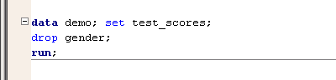

Selecting variables
Can be written as statements in a DATA step or as DROP= / KEEP= DATA step options
Which method you use will affect which variables are available within the DATA step as well as processing efficiency.

Slide 6
Selecting variables
Can be written as statements in a DATA step or as DROP= / KEEP= DATA step options
All variables (including gender) will be read to into working memory.
Gender will be excluded when ‘DEMO’ dataset is written .
Gender available for use in the DATA step
Less processing efficiency

Slide 7
Selecting variables
Can be written as statements in a DATA step or as DROP= / KEEP= DATA step options
Gender will not be read to into working memory
(and will be excluded when ‘DEMO’ dataset is written )
Gender not available for use in the DATA step
More processing efficiency

Slide 8
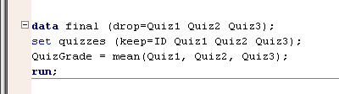
Selecting variables
Can use DROP= and KEEP= together
ID, Quiz1, Quiz2, and Quiz3 will be read into working memory (and available for use in the DATA step)
Only ID and QuizGrade will be written to the “Final” dataset

Slide 9
Appending Datasets

Slide 10
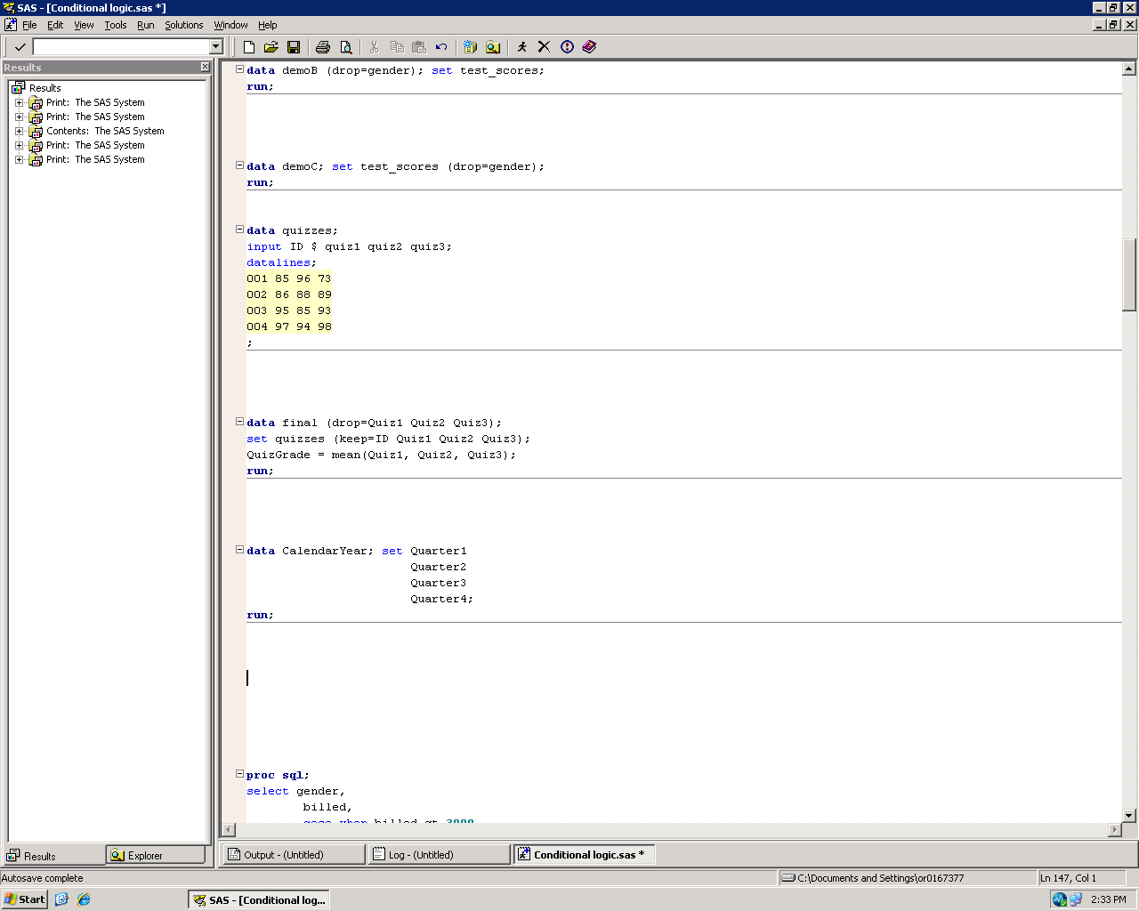
SET statement
The simplest method for adding observations to a SAS dataset is through the SET statement
Datasets are simply stacked on top of each other (concatenation)
Can use a BY statement to interleave datasets (if input datasets are sorted)
Duplicate observations are not overwritten

Slide 11
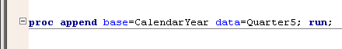
PROC Append
SET statement method works best if datasets are small and manageable
For better processing efficiency, use PROC Append
Can only append one dataset at a time
Input datasets must have same variables and attributes (otherwise use FORCE option)
Master (larger) dataset
Smaller dataset to be added

Slide 12
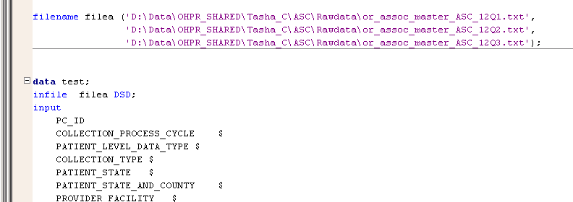
Appending raw data
Use FILENAME statement to append raw data during input
Input datasets must have same format (same variables and attributes)

Slide 13
Joins and Merge

Slide 14
Joins and merges
Merging data – combining columns from two or more datasets
Can use DATA step MERGE statement or PROC SQL
Can produce inner joins and outer joins
Can merge entire datasets or subsets of datasets
Can produce one-to-one and one-to-many, but not many-to-many joins
Can produce many-to-many joins in PROC SQL

Slide 15
MERGE statement
Input datasets must have a common identifying variable (primary key)
Input datasets must be sorted by this key variable
Key variable must have same name and attributes
All other variables must have a unique name or they will be overwritten by last merged dataset

Slide 16
One-to-one joins
Quiz 1
Quiz 2
One-to-one
Student_ID | Quiz1
001 | 85
002 | 86
003 | 95
004 | 97
Student_ID | Quiz2
001 | 96
002 | 88
003 | 85
004 | 94

Slide 17
One-to-one joins
Quiz 1
Quiz 2
One-to-one
Student_ID | Quiz1 | Quiz2
001 | 85 | 96
002 | 86 | 88
003 | 95 | 85
004 | 97 | 94

Slide 18
One-to-many joins
Student demographics
Courses taken
One-to-many
Student_ID | Course_Title
001 | Psychology 101
001 | Philosophy 105
001 | Math 212
002 | Writing 222
002 | Psychology 101
002 | Spanish 301
… | …
Student_ID | Gender
001 | F
002 | M
003 | M
004 | F

Slide 19
One-to-many joins
Student demographics
Courses taken
One-to-many
Student_ID | Gender | Course_Title
001 | F | Psychology 101
001 | F | Philosophy 105
001 | F | Math 212
002 | M | Writing 222
002 | M | Psychology 101
002 | M | Spanish 301
… | … | …

Slide 20
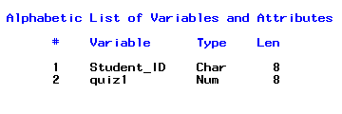
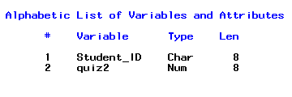

MERGE statement
Example – 3 datasets
PersQuiz
Want one dataset with all three quiz grades
SocQuiz
CogQuiz

Slide 21
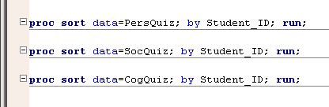
MERGE statement
First sort the datasets using the PROC Sort
Datasets must be sorted or the merge will not work properly

Slide 22
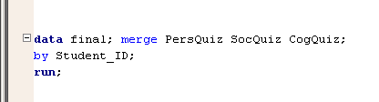
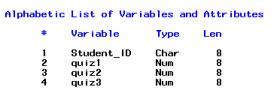
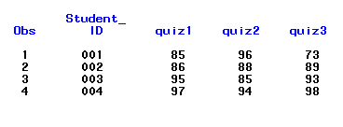
MERGE statement
Then merge in the DATA step

Slide 23
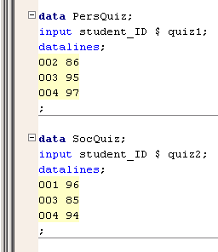
Inner Joins
Example – 2 datasets
Some students took quiz 1, but not quiz 2
Some students took quiz 2, but not quiz 1
Some students took both quizzes

Slide 24
Inner Joins
Students
who took
quiz 1
Students
who took
quiz 2
Students who took both quizzes

Slide 25
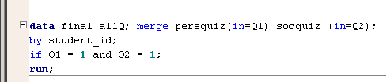
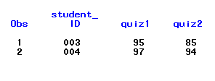
Inner Joins
Use the IN= option
Use IN= to create temporary aliases for the input datasets
Use subsetting IF to only include observations in both datasets
Q1 = 1 means the observation is in the Q1 (PersQuiz) dataset

Slide 26
Excluding Joins
Students
who took
quiz 1
Students
who took
quiz 2
Students who took both quizzes

Slide 27
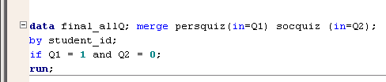
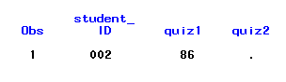
Excluding Joins
Who took Quiz 1, but not Quiz 2?
We’ll discuss other inner and outer joins with PROC SQL
Use subsetting IF to only include observations in one dataset that are not in the other
Q2 = 0 means the observation is in not Q2 (SocQuiz) dataset

Slide 28
SAS SQL Procedure
The SQL procedure is SAS implementation of Structured Query Language.
PROC SQL is part of Base SAS software, and you can use it with any SAS data set (table).
SAS language elements such as global statements, data set options, functions, informats, and formats can be used with PROC SQL just as you can with other SAS procedures
PROC SQL can be used in an interactive SAS session or within batch programs

Slide 29
Applications of SQL
PROC SQL can :
generate reports
generate summary statistics
retrieve data from tables or views
combine data from tables or views
create tables, views, and indexes
update the data values in PROC SQL tables
update and retrieve data from DBMS tables
modify a PROC SQL table

Slide 30
Terminology
Tables :
A PROC SQL table is the same as a SAS data file. It is a SAS file of type DATA. PROC SQL tables consist of rows and columns.
Queries :
Queries retrieve data from a table, view, or DBMS. A query returns a query result, which consists of rows and columns from a table.
Views :
PROC SQL views do not actually contain data as tables do. Rather, a PROC SQL view contains a stored SELECT statement or query. The query executes when you use the view in a SAS procedure or DATA step. When a view executes, it displays data that is derived from existing tables or from other views
Null Values :
To be compatible with the rest of SAS, PROC SQL treats missing values the same as blanks or zero values, and considers all three to be null values.

Slide 31
SELECT and FROM, WHERE Clauses
SELECT and FROM Clauses :
select Name from sql.countries;
WHERE Clause : Enables you to restrict the data that you retrieve by specifying a condition
select Name
from sql.countries
where Population gt 5000000;

Slide 32
ORDER BY Clause
The ORDER BY clause enables you to sort the output from a table by one or more columns;
you can put values in either ascending or descending alphabetical order The default order is ascending
select Name from sql.countries
where Population gt 5000000
order by Population desc;

Slide 33
GROUP BY Clause
The GROUP BY clause enables you to break query results into subsets of rows. When you use the GROUP BY clause, you use an aggregate function in the SELECT clause or a HAVING clause to instruct PROC SQL how to group the data.
Exp:
select Continent,
sum(Population) as total
from sql.countries
group by Continen
continent | Country | Population
AUSTRALIA | AUSTRALIA | 26
ASIA | INDIA | 1000
ASIA | PAK | 250
EUROPE | UK | 88
continent | total
ASIA | 1250
AUSTRALIA | 26
EUROPE | 88

Slide 34
HAVING Clause
The HAVING clause works with the GROUP BY clause to restrict the groups in a query's results based on a given condition. PROC SQL applies the HAVING condition after grouping the data and applying aggregate functions
select Continent, sum(Population) a
from sql.countries
group by Continent
having Continent in ('Asia', 'Europe')
order by Continent;
continent | Country | Population
AUSTRALIA | AUSTRALIA | 26
ASIA | INDIA | 1000
ASIA | PAK | 250
EUROPE | UK | 88
continent | total
ASIA | 1250
EUROPE | 88

Slide 35
Ordering the SELECT Statement
When you construct a SELECT statement, you must
specify the clauses in the following order:
SELECT
FROM
WHERE
GROUP BY
HAVING
ORDER BY

Slide 36
Retrieving Data from Multiple Tables
The data that you need for a report could be located in more than one table.
In order to select the data from the tables, join the tables in a query.
Joining tables enables you to select data from multiple tables as if the data were contained in one table.
Joins do not alter the original tables.
1.)Cartesian Product
2.)Inner Join
3.)Outer Join
a.)Left outer Join
b.)Right outer Join

Slide 37
Example Tables
Table T2
Table T1
Column1 | Column2
aaa | bbb
ccc | ccc
xxx | yyy
hhh | zzz
Column1 | Column2
ggg | hhh
xxx | zzz

Slide 38
<> Joining tables in this way returns the Cartesian product of the tables. <> Each row from the first table is combined with every row from the second table
Cartesian product or Cross Join
Column1 | Column2 | Column1 | Column2
aaa | bbb | ggg | hhh
aaa | bbb | xxx | zzz
ccc | ccc | ggg | hhh
ccc | ccc | xxx | zzz
xxx | yyy | ggg | hhh
xxx | yyy | xxx | zzz
hhh | zzz | ggg | hhh
hhh | zzz | xxx | zzz
proc sql;
SELECT * FROM Table1
CROSS JOIN Table2

Slide 39

Inner Join
An inner join returns only the subset of rows from the first table that matches rows
from the second table.
You can specify the columns that you want to be compared for matching values in a WHERE clause.

Slide 40
Contd..
proc sql;
SELECT * FROM Table1
NATURAL JOIN Table2;
Column1 | Column2 | Column1 | Column2
xxx | yyy | xxx | zzz

Slide 41

Left outer Join
A left outer join lists
all rows from the left-
hand table .
The rows that do not
match any row in the right
hand table filled with null.
A left join is specified with
the keywords LEFT JOIN
and ON.

Slide 42
Contd..
proc sql ;
Select *
from Table1 as T1
Left Outer Join Table2 as T2
on T1.Column1=T2.Column3;
Column1 | Column2 | Column1 | Column2
aaa | bbb
ccc | ccc
xxx | yyy
hhh | zzz | ggg | hhh

Slide 43

Right outer Join
A right outer join lists
all rows from the right-
hand table .
The rows that do not
match any row in the left
hand table filled with null.
A Right join is specified
With the keywords Right Join
and ON.

Slide 44
Contd..
proc sql ;
Select *
from Table1 as T1
Right Outer Join Table2 as T2
on T1.Column1=T2.Column3;
Column1 | Column2 | Column1 | Column2
hhh | zzz | ggg | hhh
 |  | xxx | zzz

